Slide 1

SNHU TRAVEL
A CHADATECH Product
CS-250
Final Project
Andrew Menard

Slide 2
Scrum-Agile Roles
Product Owner
Scrum Master
Development Team
Notes:
Picture citations:
(kirankaursingh)
(Kukhnavets)

Slide 3
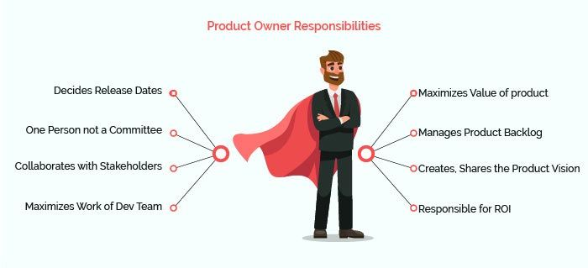
PRODUCT OWNER
Sets the product vision for the team
The Product Owner ensures the Scrum Team is aligned with goals of the overall project.
Communicates with Stakeholders/Client
Translate needs of stakeholders to the team
Understands Market Trends, customer expectations and business needs of product
Notes:
Picture citation:
(Product Owner vs Scrum Master: Key Differences, n.d.)
Resources:
(The Four Scrum Events and How to Use Them [0 SEU], n.d.)
(The 3 Scrum Roles and Responsibilities, Explained, n.d.)

Slide 4
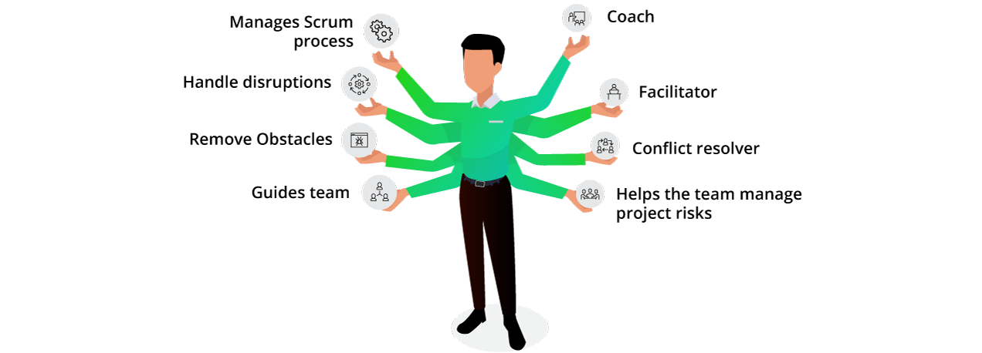
SCRUM MASTER
Ensures team is working as efficiently as possible and following Scrum values
Both a leader and behind-the-scenes supporter – “Servant Leader”
Facilitates daily Scrum meetings
Protector – removes impediments to the team's progress
Leads and coaches' team in adopting Agile methodology
Notes:
Picture citation:
(Product Owner vs Scrum Master: Key Differences, n.d.)
Resources:
(The Four Scrum Events and How to Use Them [0 SEU], n.d.)
(The 3 Scrum Roles and Responsibilities, Explained, n.d.)

Slide 5

DEVELOPMENT TEAM
Consists of developers, testers, designers, writers, programmers, etc..
Ideal size of development team is 3-9 people. Enough people to eat two pizzas
Decides how to complete work set by Product Owner
Empowered to plan how to organize work at agreed upon level of quality
Set the “definition of done” and work to that level
Manages the sprint backlog
Tests products and provides quality assurance
Collaborates cross-functionally
Determines and sets sprint iterations
Notes:
Picture citation:
(Product Owner vs Scrum Master: Key Differences, n.d.)
Resources:
(The Four Scrum Events and How to Use Them [0 SEU], n.d.)
(The 3 Scrum Roles and Responsibilities, Explained, n.d.)

Slide 6
PHASES OF AGILE
1. Create Product Backlog
2. Sprint Planning
Creates vision of the project
Form Scrum Team
Transform large tasks into smaller user stories
Prioritize product backlog and user stories
Initial estimates
This step is important because it breaks the large goal into bite size pieces to be worked, and then prioritizes the order.
Gets whole team to understand scope of the project
Typically lasts two weeks.
A small sprint allows for more customer feedback so that bugs can be worked out earlier.
A long sprint allows the developers to be thorough. Important to find a balance of the two.
Select user stories and prioritize into smaller tasks, creating Sprint Backlog.
Set “Definition of Done”
Important because this sets what work will be done over the next two weeks
Notes:
Resources:
(Overview of Scrum Phases | StarAgile, n.d.)
(Phases and Processes in Scrum Project| SCRUMstudy, 2017)

Slide 7
PHASES OF AGILE
3. Sprint
4. Testing and Review
This is the stage when deliverables are created.
Works on tasks in sprint backlog
Consists of daily standups before each day to go over progress, concerns, progress, etc..
Scrum meetings are important for tracking progress and who is doing what tasks
Burndown chart comes from scrum meetings. This provides details about tasks completed and issues in completing tasks
Groom prioritized product backlog
Tests that the deliverables are completed to the agreed upon definition of done.
Quality Assurance
Completed sprints are to be demonstrated to customer for their acceptance and viewpoint of the completed solution.
Notes:
Resources:
(Overview of Scrum Phases | StarAgile, n.d.)
(Phases and Processes in Scrum Project| SCRUMstudy, 2017)

Slide 8

PHASES OF AGILE
5. Retrospective and next Sprint Planning
Review what went well and what didn’t on last sprint.
Look for places to improve process and efficiency.
Learn from mistakes, takeaway lessons learned.
Take this knowledge to commence planning of next sprint.
An important step because it gives team the opportunity to prevent issues for next sprint
Notes:
Resources:
(Overview of Scrum Phases | StarAgile, n.d.)
(Phases and Processes in Scrum Project| SCRUMstudy, 2017)

Slide 9
Waterfall Method
Requirements
Make predications as accurate as possible for roadblocks. Requires customer to have comprehensive idea of what they what end product to be.
Design
Design sections according to plan made during planning
Implementation
Implement all completed tasks together. Troubleshoot as issues arise.
Verification/Testing
Cannot move to next phase until all bugs and issues are completed
Deployment & Maintenance
Launch project and continue maintenance.
The process would have been different using a waterfall approach because all of the tasks are pre planned at the beginning of the project. This does not give much room for adjusting as the project moves along. This can be problematic if the customer doesn’t have an exact idea of how they want the whole project to be completed from the start. For instance, when the customer decided they wanted to focus on the healthy vacation niche, we were able to adjust accordingly on the next sprint. If we were using the waterfall approach, the team would not have been able to make the changes so easily. It would have required much more backtracking and unnecessary extra work. Agile allows much more communication and feedback from the client giving them a better experience. It also gives the team a more organized and realistic approach to developing software.

Slide 10

Choosing An Approach - Agile
When choosing whether to use a waterfall or Agile approach, there are multiple things to consider.
Agile is ideal when:
The client is uncertain about certain requirements for the project, wants to be involved in the development, or if timelines are short.
If there are few initial requirements
If Project does not need to meet strict regulations
If team is building an innovative product that doesn’t exist
If the budget has some flexibility
Notes:
Resources:
(Parsons, 2019)

Slide 11



Choosing An Approach - Waterfall
The Waterfall approach is best when:
There are many initial product requirements.
There are strict regulatory requirements.
If the client does not want to be closely involved in the development.
If the team is delivering an enhancement to an existing product
If the budget and/or timeline is not flexible
Notes:
Resources:
(Parsons, 2019)

Slide 12

The team has determined that adopting the Agile methodology was the best choice for this particular project. It gave the team and the client the flexibility to make adjustments as the project developed. The client appreciated being involved and they were able to provide feedback. The team was able to collaborate and work cross-functionally in order to increase efficiency. We were able to review each sprint and learn who was best assigned to certain tasks. The project was completed successfully and efficiency because of this process.
Summary

Slide 13




Thank you
Andrew Menard
CS-250
Final Project

Slide 14
Resources
. How to know if a developer uses agile. (2018, July 24). IT and Tech Recruitment | Nederlia. https://nederlia.com/how-to-know-if-a-developer-uses-agile/
kirankaursingh. “Owning It: The Role of the Agile Product Owner.” Highlights - Gladwell Academy, https://blogs.gladwellacademy.com/owning-it-the-role-of-the-agile-product-owner. Accessed 24 Apr. 2022.
Kukhnavets, Pavel. “What Is an Agile Developer?” Hygger.io Guides, 13 Jan. 2022, https://hygger.io/guides/agile/software-development/agile-developer/.
Overview of Scrum Phases | StarAgile. (n.d.). Staragile.com. https://staragile.com/blog/scrum-phases
Parsons, T. (2019, May 17). When to Use Waterfall vs. Agile | Macadamian. Macadamian. https://www.macadamian.com/learn/when-to-use-waterfall-vs-agile/

Slide 15
Resources
Phases and processes in Scrum project| SCRUMstudy. (2017). Scrumstudy.com. https://www.scrumstudy.com/whyscrum/scrum-phases-and-processes
Product Owner vs Scrum Master: Key Differences. (n.d.). Www.knowledgehut.com. https://www.knowledgehut.com/blog/agile/scrum-master-and-product-owner-understanding-the-differences
The 3 Scrum Roles and Responsibilities, Explained. (n.d.). Coursera. https://www.coursera.org/articles/scrum-roles-and-responsibilities
The Four Scrum Events and How to Use Them [0 SEU]. (n.d.). Resources.scrumalliance.org. https://resources.scrumalliance.org/Article/scrum-events

